Slide 1
Seven Segment Displays

Slide 2
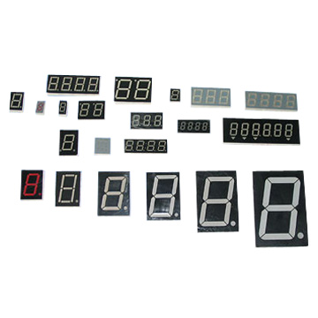
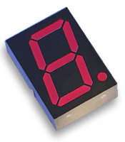
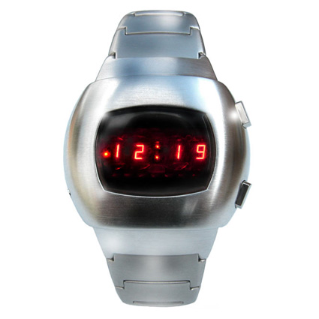
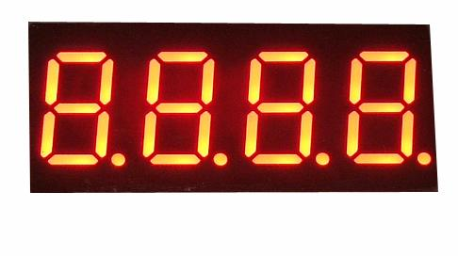
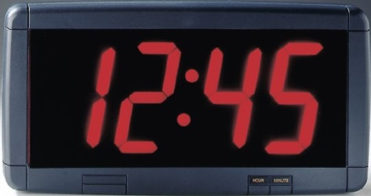
Seven Segment Displays
A seven-segment display can be used to display the decimal numbers 0-9 and some alpha characters.

Slide 3
Segment Identification
a
A Seven-Segment Display (SSD) is simply a figure eight grouping of LEDs { include a decimal point (DP)}.
Each Segment is labeled (a) to (g).
SSDs are available in two configurations
Common Cathode (all LED cathodes are connected)
Common Anode (all LED anodes are connected)
f
b
g
e
c
d
dp

Slide 4
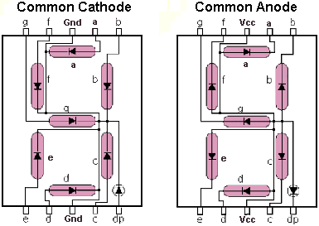
Common Cathode & Common Anode

Slide 5
SSD Display Possibilities
Decimal Digits 0-9
Select Alpha Characters
Simple Messages

Slide 6
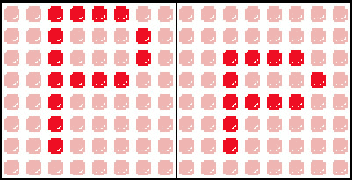
Display character

